Slide 1
Research Methods: Thinking critically with psychological science
Unit 2

Slide 2
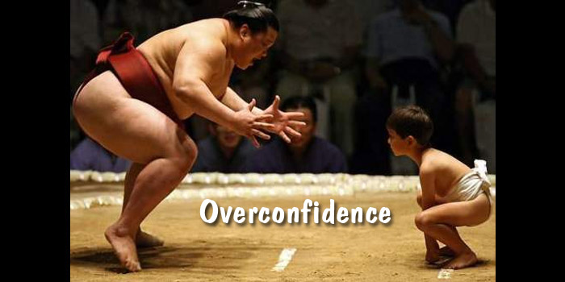
The Need for Psychological Science
Why is the scientific approach better than intuition/common sense?
Hindsight Bias (also known as I-knew-it-all-along phenomenon)
Overconfidence
We think we know more than we do (unscramble anagrams)

Slide 3
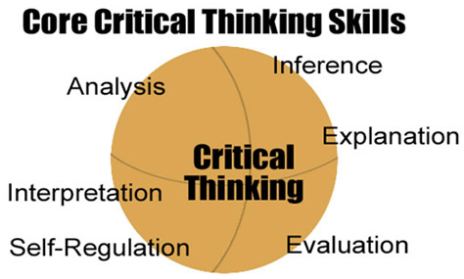
The Need for Psychological Science
The Scientific Attitude
Curiosity, Let the facts speak for themselves
Be skeptical, but not cynical, open but not gullible.
Have humility; “the rat is always right”
Critical thinking
Question everything!

Slide 4
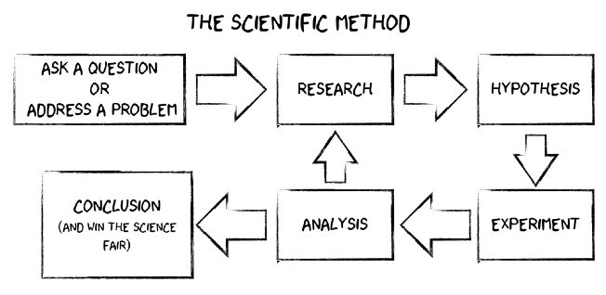
How do psychologists ask and answer questions?
The scientific method
Theory: organized observations
Hypothesis: testable predictions of the theory
Confirm, reject, revise
Operational definitions: a statement of procedures used to define research variables that can be replicated.
Useful theories:
Effectively organize a range of self-reports and observations…and
Implies clear predictions that anyone can use to check the theory or to derive practical implications

Slide 5
How do psychologists ask and answer questions?
Description: not to be mistaken for explanation of behavior.
The Case Study: The study of an individual in hopes that it reveals something about us all.
Ex: Piaget, brain damaged victims
The Survey: Sampling from a representative population (hopefully) generalization about the whole population.
Wording effects
Random sampling
How do you choose a sampling representative of EHS?
Voting samples accuracy?
Naturalistic Observation: recording behavior in
the natural environment.
Outside of the lab.

Slide 6
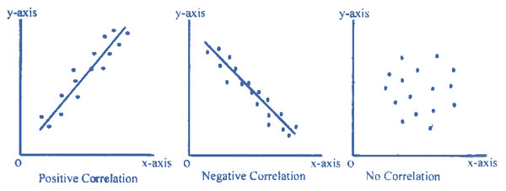
How do psychologists ask and answer questions?
Correlation: the extent to which two factors predict one another.
Positive vs. Negative correlations
Correlation coefficient: statistical index of relationship (between -1 to +1)
Scatterplots

Slide 7
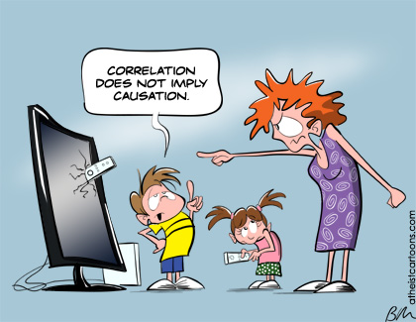
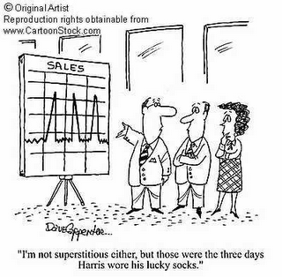
How do psychologists ask and answer questions?
Correlation and Causation
Illusory Correlation

Slide 8
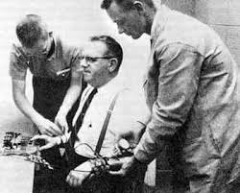
How do psychologists ask and answer questions?
Perceiving Order in Random Events
Making sense of the world?
Heads vs. Tails (Flip a coin 100 times, all tails, what are the chances the next flip will also be tails?
Experimentation: allows experimenter to focus on possible effects by:
Manipulating the factors of interest….and
Holding constant (controlling) other factors.

Slide 9
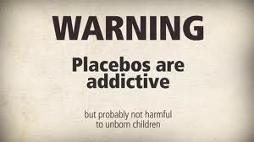
How do psychologists Ask and Answer Questions?
Experimentation:
Random Assignment: assigning participants in an experiment using chance to a control group and an experimental group.
Double Blind procedure: neither participant or researcher knows who is in the control or experimental group.
Fantasy football example
Placebo effect: experimental results caused by expectations alone.

Slide 10
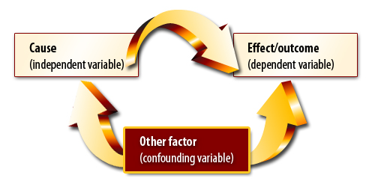
How do psychologists Ask and Answer Questions?
Experimentation:
Variables:
Independent: the factor manipulated; the variable whose effect is being studied.
Dependent: the variable that may change in response to the IV
Confounding: a factor other than the IV that may produce an effect of an experiment.

Slide 11
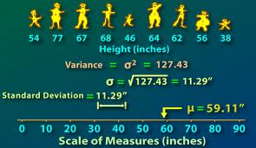
Statistical Reasoning in Everyday Life
Describing data:
Measure of Central Tendency (positive vs. negative skew)
Mode: The most frequently occurring score(s) in a distribution
Mean: The average of distribution
Median: The middle score of a distribution
Measures of variation
Range: The difference between the highest and lowest scores
Standard Deviation: a computed measure of score variability around the mean score.
Normal curve: a bell shaped curve with the 68, 95, and 99.7% rule

Slide 12
Statistical Reasoning in Everyday Life
Making Inferences:
Can we make generalizations from samples to show significance?
When is an observed difference reliable?
Representative samples are better than biased samples
Less-variable observations are more reliable than those that are more variable.
More cases are better than fewer
Remember…don’t be impressed by a few anecdotes; generalizations based on a few unrepresentative cases are unreliable.
Ex: autisms correlation with vaccines.

Slide 13
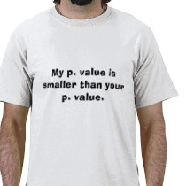
Statistical Reasoning in Everyday Life
Making Inferences
When is a difference significant?
When the sample averages are reliable, we say they have statistical significance (how likely an obtained result occurred by chance.)
Statistical significance indicates the likelihood a result will happen by chance, not the importance of the result.

Slide 14
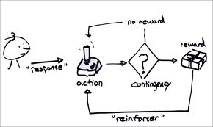
Frequently Asked Questions in Psychology
Applied Psychology
Can laboratory experiments illuminate everyday life?
The resulting principles, not specific findings help explain everyday life.
Lab environment intended to simplify reality using controls.
Psychologists’ concern are not focused on unique behaviors, but rather discovering general principals that help explain behaviors.

Slide 15
Frequently Asked Questions in Psychology
Applied Psychology:
Does behavior depend on one’s culture and gender?
Culture: shared ideas and behaviors that one generation passes on to the next.
Each person in certain respects is like no other, like some others, and like all others…think about it.
The genders show many differences including:
Dreaming, detecting emotions, and our risk for dependences and disorders.
Biologically, the genders are very similar (development and perceptions)
Genders can vary across cultures, but the underlying processes are virtually the same.

Slide 16
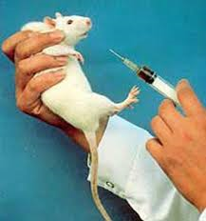
Frequently Asked Questions in Psychology
Ethics in Research
Why do psychologists study animas, and is it ethical to experiment on them?
Debate:
Is it right to place the well-being of humans above animals?
Do we give more compassion to animals similar to us, like we would an individual similar to us? (1. humans, 2. mammals, 3. birds, fish, reptiles, 4. insects)

Slide 17
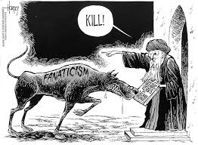
Frequently Asked Questions in Psychology
Ethics in Research
Is it ethical to experiment on people?
Informed consent
Debrief
Is psychology free of value judgments?
One person’s religion is another person’s fanaticism.
Knowledge can be used for good or evil.

